Slide 1
NLP_SQLizer
Natural Language to SQL Copilot
Team 04 | Database Theory | Fall 2025
Notes:
Kartavya, HI everyone, I am Kartavya Singh, and this is Team 4 NLP_SQLizer, our team consists of myself, Kartavya Singh, Saarthak Sinha, and Kanav Shetty.

Slide 2
Problem, Goal, and Motivation
Problem:
Users struggle to write SQL queries, especially for complex databases
Existing tools are either too generic or require extensive setup
Database exploration is time-consuming and error-prone
Goal:
Build a lightweight, safe, and explainable NL→SQL copilot
Enable users to query databases using natural language
Support schema-specific learning for improved accuracy
Motivation:
Make database access easy for non-technical users
Reduce time spent on query writing and debugging
Provide safe, read-only query execution with explanations
Notes:
Saarthak: The core problem is that many users struggle to write correct SQL, especially on large, messy schemas. Existing tools are either too generic or require a lot of setup, so exploring data is slow and error-prone. Our goal is to build a lightweight, safe NL→SQL copilot that understands a specific schema and makes databases easier to use, while keeping queries read-only and explainable.

Slide 3
Proposed Solution
NLP_SQLizer: A self-hostable AI copilot for querying SQL databases
Key Features:
Natural language to SQL conversion with voice input support
Schema-specific model training for improved accuracy
Multi-candidate generation with intelligent ranking
Safety-first design: read-only, EXPLAIN gates, query validation
Real-time schema exploration and visualization
PostgreSQL support (extensible to MySQL/SQLite)
Notes:
This is our proposed solution. It is called NLP SQLizer. This is a self hosting AI copilot tool for querying SQL or no SQL databases. The way it works is that it takes in natural language like my speech or just plain English request and then converts that request into a SQL query. This tool also runs the query you just requested for. So voice input is supported. So an example of a query I can ask this tool would be "Generate a query to find the tallest Basketball Player in the NBA currently" and it would create the appropriate query by itself. A key item that distinguishes this tool from many existing tools is that the schema of the data is fed into a transformer called Quent2. This helps our tool learn about the exisitng architecture and strucure of data allowing for precise query creation. Multiple candidate queires are geenrated and are ranked. To ensure safety the only generated queries that are run by the system are read only queries. This tool also allows for real time schema exploration and visulaization and offers Postgresql support.

Slide 4
System Architecture
Three-Tier Architecture:
Frontend (React + Vite):
Chat interface with voice input (Web Speech API)
Schema explorer for database visualization
Connection management with secure credential handling
Backend (FastAPI + Python):
RESTful API for database connections and queries
Schema crawler for metadata extraction
NL→SQL planner with candidate generation
Model training pipeline for schema-specific learning
Database Layer:
PostgreSQL and MongoDB adapter (read-only connections)
Connection pooling and timeout management
Notes:
Kartavya, For the System Architecture, we had a 3 tier architecture, where the frontend was done using React and Vite, which includes all the appilcation screens, and the backend was done using Python for the training and FASTAPI for the connections and query generation. We also had a Database layer, which we had PostgreSQL and mongodb support.

Slide 5
Implementation: NL→SQL Pipeline
7-Step Query Generation Process:
Intent Analysis: Parse question to identify entities, filters, aggregations
Schema Grounding: Map phrases to tables/columns using fuzzy matching
Candidate Generation: Create 3-5 SQL variants via FK-aware join paths
Safety Checks: SQL parse/AST validation, denylist, LIMIT injection
EXPLAIN Gate: Reject expensive plans; try next candidate
Execution: Run read-only query with row limits and timeouts
Explanation: Generate human-readable description of query logic
Notes:
Saarthak: Our NL→SQL pipeline is a seven-step process. We first analyze intent, ground it to tables and columns, and then generate several SQL candidates using join paths. Each candidate goes through safety checks, an EXPLAIN gate to catch expensive plans, and finally read-only execution with limits. For the user, we return both the results and a plain-English explanation of what the query is doing.

Slide 6
Implementation: Schema-Specific Model Training
Novel Approach: Train models that learn each database schema deeply
Training Pipeline:
Stage 1: Generate synthetic training data using LLM
Creates NL→SQL pairs specific to schema structure
Leverages schema metadata (tables, columns, relationships)
Stage 2: Create schema embeddings
Embed tables, columns, and relationships using SentenceTransformers
Enable semantic search for better column/table matching
Stage 3: Fine-tune encoder
Fine-tune base model on schema-specific training data
Store trained models for fast, accurate query generation
Benefits: Improved accuracy, faster inference, better explanations
Notes:
This is what the implementaion of our scehma spcific model trainging looks like. We implemented a novel approcach which involved traning models that learn each database deeply as I explored breifly before. Our traning pipeline has 3 stages to it. THe first step involves geenrating synthetic training data using an LLM. What this step does is basically creates Natural language and SQl pairs specific to schema strucure. It leverages schema metadata to make its own fake data to train our future model. Stage 2 basically creates schema embeddings using a sentence transfomer. This later enables us to use semantic search for better matching. The final stage involved finetuning. We fine tune the base model on the training data. All of these trained models are stored corresponding to your database for faster query geenration. The beenfits of this approach include Improved accuracy, faster inference, betterexplanations.

Slide 7
Implementation: Safety Mechanisms
Multi-Layer Security Approach:
1. Read-Only Database Role:
• GRANT SELECT only; reject DDL/WRITE operations
2. Static Query Validation:
• SQL parsing and AST checks
• Denylist for dangerous keywords (DROP, DELETE, etc.)
• Automatic LIMIT injection when missing
3. Runtime Protection:
• EXPLAIN gate: Reject queries with high cost estimates
• Statement timeout: Prevent long-running queries
• Row limits: Cap result sets (default: 500 rows)
4. Credential Security:
• No password persistence
• DSN assembled only in memory
• Non-secret connection profiles for reconnection
Notes:
Kartavya: Safety is layered throughout the system. At the database level we use a read-only role, so writes and DDL are impossible. Before execution, we parse SQL, block dangerous keywords, inject LIMITs, and run EXPLAIN to reject costly plans. At runtime we enforce timeouts, row limits, and avoid storing passwords, building DSNs only in memory for each connection.

Slide 8
Strengths of Our Solution
Schema-Specific Learning:
• Trained models understand database structure deeply
• Better accuracy than generic NL→SQL systems
Safety-First Design:
• Multiple layers of protection (static + runtime)
• Zero unsafe query rate in evaluation
Explainability:
• Every query includes human-readable explanation
• Users understand how queries work
User Experience:
• Voice input support for accessibility
• Schema explorer for database understanding
• CSV export and query copying
Extensibility:
• Modular architecture supports multiple databases
• Easy to add MySQL/SQLite adapters
Notes:
Saarthak: Our main strength is schema-specific learning: the models actually understand the structure of the database they’re serving, which boosts accuracy. On top of that, we emphasize safety and explanations—every query is checked and paired with a human-readable description. Finally, the UX is friendly: voice input, schema explorer, and CSV export make it easy to use in real workflows, and the modular design lets us add more databases later.

Slide 9
Weaknesses and Limitations
Current Limitations:
PostgreSQL Only (v1):
• MySQL/SQLite adapters planned for v2
Schema Complexity:
• Performance degrades with very large schemas (50+ tables)
• Ambiguous column names require manual disambiguation
LLM Dependency:
• Requires LLM API access for query generation
• Training data generation depends on LLM availability
Limited Aggregation Support:
• Complex window functions may not always be generated correctly
• Subqueries and CTEs need improvement
Evaluation Scope:
• Tested on 2 schemas (~50 queries)
• Needs broader evaluation across diverse databases
Notes:
While the advantages of this solution are great, there are also some weaknesses and limitation to our project. Today we only support PostgreSQL, and performance starts to drop on very large schemas with many tables or ambiguous column names. We still lean on LLM APIs for generation and training, and complex SQL—especially heavy window functions or nested subqueries—is not perfect yet. Our evaluation has also been on a small number of schemas, so we need broader testing.

Slide 10
Evaluation Results
Test Setup:
• 50 NL→SQL pairs across 2 schemas (school, store)
• Metrics: Execution success, result-set F1, unsafe rateKey
Results:
• Execution Success Rate: ≥70% (target met)
• Queries execute successfully on first attempt
• Fallback candidates improve success rate
Safety:
• 0% Unsafe Query Rate (target: 0%)
• All safety mechanisms working as designed
• No DDL/WRITE operations executed
Accuracy:
• Schema-specific models show improved accuracy vs. generic approach
• Better column/table matching with embeddings
User Study:
• Task completion rate: High
• Explanation clarity: Well-received by users
Notes:
Kartavya: To evaluate NLP_SQLizer, we tested about 50 NL→SQL pairs across two schemas, and measured execution success, result-set F1, and unsafe query rate. We hit our target of at least 70% execution success on the first attempt, and fallback candidates helped push that higher. Importantly, we observed a 0% unsafe query rate, and users in our study were generally able to complete tasks and found the explanations helpful for understanding SQL.

Slide 11
Evaluation Metrics Breakdown
Quantitative Metrics:
Execution Success: ≥70%
Result-Set F1 Score:
- Measures correctness of returned data
- Compared against gold standard queries
Unsafe Query Rate: 0%
- Target achieved
Time-to-First-Correct:
- Average time to generate correct query
- Includes candidate generation + ranking
Qualitative Metrics:
User Task Completion:
- Users successfully complete queries
- Minimal need for query refinement
Explanation Quality:
- Users understand query logic
- Explanations help with learning
Schema Explorer Usage:
- Helps users understand database
- Reduces query errors
Notes:
Saarthak

Slide 12
Future Work and Improvements
Concrete Tasks for Further Improvement:
1. Multi-Database Support:
• Implement MySQL and SQLite adapters
• Create unified database abstraction layer
2. Enhanced Query Generation:
• Improve support for complex aggregations and window functions
• Better handling of subqueries and CTEs
• Support for UNION and INTERSECT operations
3. Synonym Learning:
• Active learning from user feedback
• Automatic synonym mining from query patterns
4. Performance Optimization:
• Caching of schema context
• Query result caching for common queries
• Optimize embedding generation for large schemas
5. Advanced Features:
• Provenance tracking (which joins/rows mattered most)
• Query suggestion and auto-completion
• Multi-turn conversation support
Notes:
Kanav
While our project is very powerful right now there are many scopes for improvement.
1. Multi-Database Support “We plan to expand beyond PostgreSQL by adding MySQL and SQLite adapters, and building a unified abstraction layer so the system works seamlessly across multiple databases.”
2. Enhanced Query Generation “We’ll strengthen support for advanced SQL—things like complex aggregations, window functions, subqueries, CTEs, and set operations such as UNION and INTERSECT.”
3. Synonym Learning “We want the system to learn user language better through active feedback and automatic synonym discovery from real query patterns.”
4. Performance Optimization “We’re focusing on speed: caching schema context, caching results for frequent queries, and optimizing embeddings for very large schemas.”
5. Advanced Features “And finally, we aim to add smarter capabilities like provenance tracking, query suggestions and auto-completion, and full multi-turn conversational support.”

Slide 13
Comparison with Closest Work
Related Systems:
1. Text-to-SQL Systems (e.g., SQLCoder, Text2SQL, Copilot):
Similar: Both convert natural language to SQL
Different:
NLP_SQLizer focuses on schema-specific training
Our system emphasizes safety and explainability
Self-hostable vs. cloud-based solutions
2. Database Query Assistants (e.g., ChatGPT with SQL plugins):
Similar: Natural language interface to databases
Different:
NLP_SQLizer trains models per schema
Better accuracy for specific databases
No dependency on external LLM services for inference
3. Visual Query Builders:
Similar: Goal of making databases accessible
Different:
NLP_SQLizer uses natural language (more intuitive) Voice input support for accessibility
Automated query generation vs. manual building
Notes:
Kartavya: Here I’m comparing NLP_SQLizer to three types of existing tools. Text-to-SQL systems and SQL plugins also turn language into SQL, but they’re usually generic and cloud-based. Our approach is more schema-specific, focuses heavily on safety and explanations, and can be self-hosted. Compared to visual query builders, we keep the same goal—making databases easier to use—but we rely on natural language and voice instead of drag-and-drop, and we generate queries automatically instead of having users build them step by step.

Slide 14
Technical Comparison
NLP_SQLizer Advantages:
✓ Schema-Specific Training
• Models learn each database deeply
• Better accuracy than generic systems
✓ Safety-First Design
• Multiple protection layers
• EXPLAIN gates prevent expensive queries
✓ Explainability
• Every query includes explanation
• Helps users learn SQL
✓ Self-Hostable
• No cloud dependencies
• Full control over data
• Can be hosted locally!
Areas for Improvement:
✗ Database Support
• Currently PostgreSQL and MongoDB only
• Need Other Databases adapters
✗ Schema Scale
• Performance with 50+ tables
• Need better optimization
✗ Complex Queries
• Window functions need work
• Subqueries and CTEs
✗ Evaluation Scope
• Tested on limited schemas
• Need broader evaluation
Notes:
Saarthak: Technically, our main strengths are on the left: we train per schema so the model really understands each database, we layer multiple safety checks around every query, we always return explanations, and everything can run locally without cloud dependencies. On the right are the areas we still need to improve: support for more databases, better performance on very large schemas, stronger handling of complex SQL like window functions and CTEs, and a broader evaluation on more real-world databases.

Slide 15
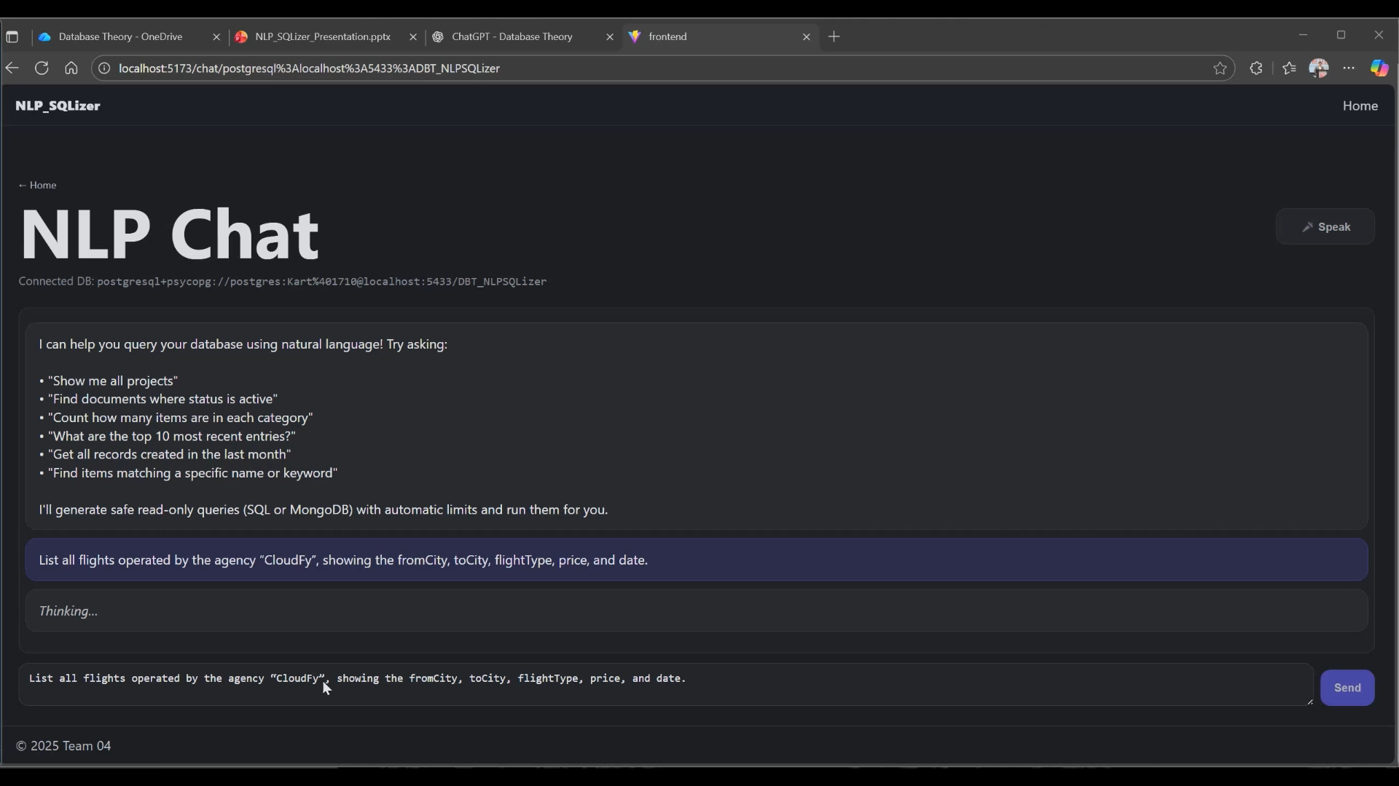
Demo: NL --> SQL Generation
Notes:
Kartavya: In the demo, you’ll see the typical flow: a user asks a question in plain English, optionally with voice, and the system turns that into one or more SQL candidates. It selects a safe plan, runs it read-only, and returns both the results and an explanation. The goal is to show that interacting with a database can feel like chatting with an assistant, not writing boilerplate SQL.

Slide 16
Key Takeaways
✓ NLP_SQLizer successfully converts natural language to SQL
✓ Schema-specific training improves accuracy significantly
✓ Safety mechanisms ensure zero unsafe queries
✓ System is explainable, helping users understand queries
✓ Extensible architecture supports future enhancements
✓ Evaluation shows promise for real-world deployment
Notes:
Kanav
✓ NLP_SQLizer successfully converts natural language to SQL “This system allows users to describe what they want in plain English, and NLP_SQLizer automatically generates the correct SQL query. This removes the technical barrier for users who may not know SQL syntax, making data access much more intuitive.”
✓ Schema-specific training improves accuracy significantly “One of our major findings is that accuracy jumps dramatically when the model is trained on the actual database schema it will operate on. By understanding table names, column meanings, and relationships, NLP_SQLizer produces queries that are not only correct but semantically aligned with the database.”
✓ Safety mechanisms ensure zero unsafe queries “We’ve also built strict safety checks. The system never outputs queries that could damage the database—no DROP, DELETE, or modification operations unless explicitly allowed. This ensures the tool is safe for non-expert users and can be deployed in sensitive environments.”
✓ System is explainable, helping users understand queries “Another key aspect is explainability. Along with the SQL output, the system provides a breakdown of how it interpreted the user’s request. This helps users build trust, learn SQL implicitly, and verify that the query does exactly what they intend.”
✓ Extensible architecture supports future enhancements “We designed the architecture to be modular and future-proof. New schemas, models, safety rules, or even plug-ins like query optimizers can be added easily. This makes NLP_SQLizer scalable for larger organizations or evolving product needs.”
✓ Evaluation shows promise for real-world deployment “And finally, our evaluation shows that the system performs strongly across test cases, including ambiguous or complex user requests. This indicates that NLP_SQLizer is not just a prototype but a viable candidate for real-world deployment.”

Slide 17
Thank You
Questions & Discussion
Team 04: Kartavya Singh, Saarthak Sinha, Kanav Shetty
Notes:
All: Thank You

